Slide 1
Info-Gap Theory: An Example of Implementation in Epidemiological Analysis
September 6, 2023
Nataliya Rybnikova

Slide 2
Part I: Linear Regression (numerical approach) Part II: Linear Regression (analytical approach)

Slide 3
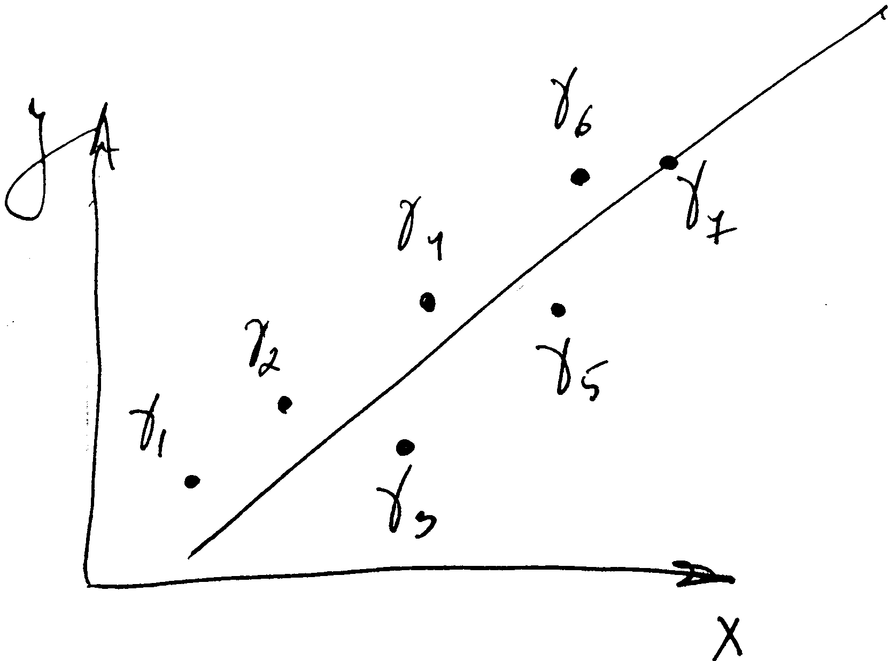
Part I: Linear Regression (numerical approach)
Initial data

Slide 4
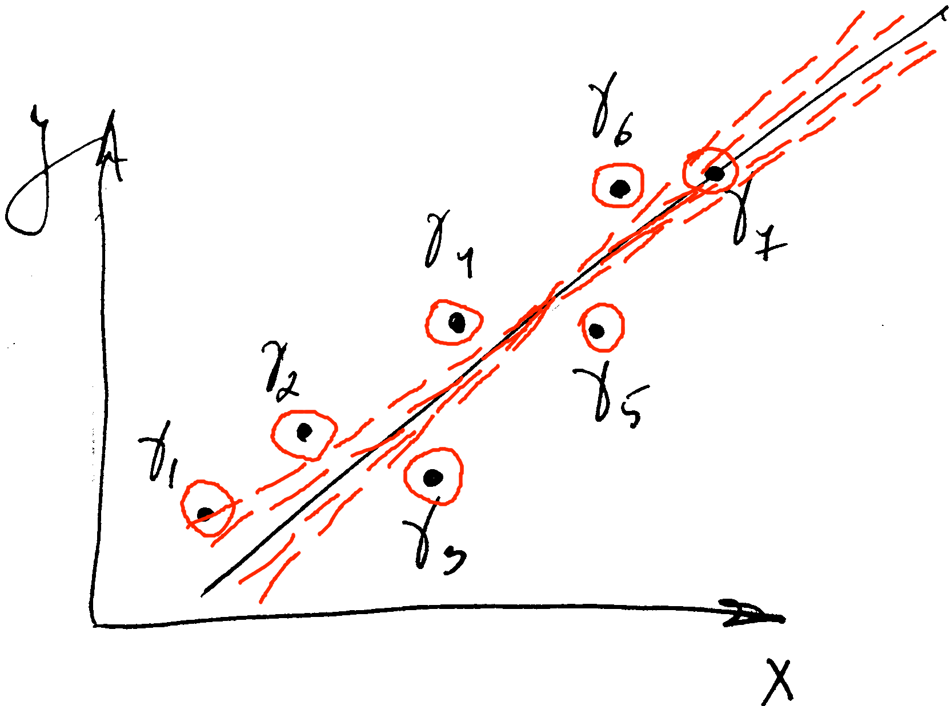
Part I: Linear Regression (numerical approach)
Initial data
Step #1

Slide 5
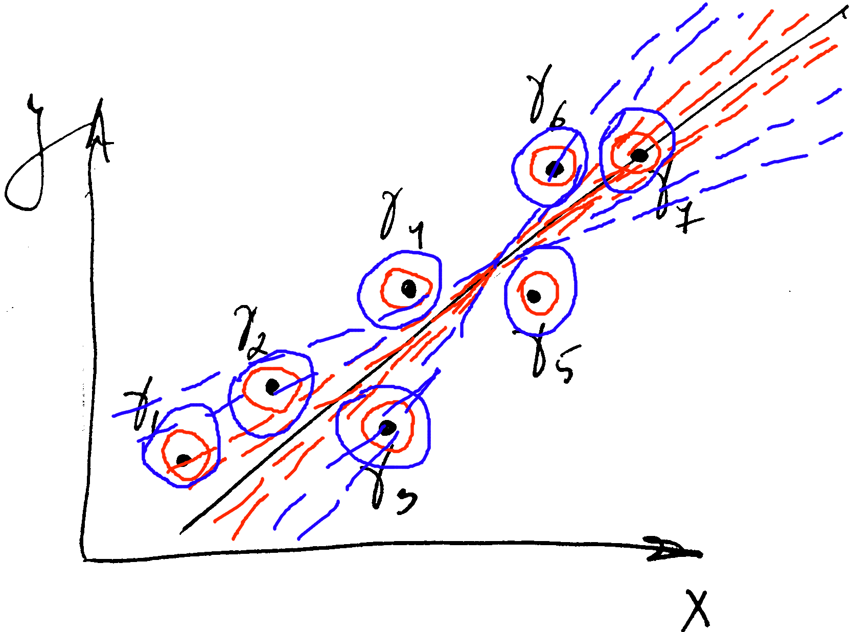
Part I: Linear Regression (numerical approach)
Initial data
Step #1
Step #2

Slide 6


Part I: Linear Regression (numerical approach)
$$γ_{i} ε{ R}^{N+1}, i ϵ \left(1..k\right)$$
$$γ_{i}=\left(x_{i1}; x_{i2};…; x_{iN}; y_{i}\right)$$

Slide 7
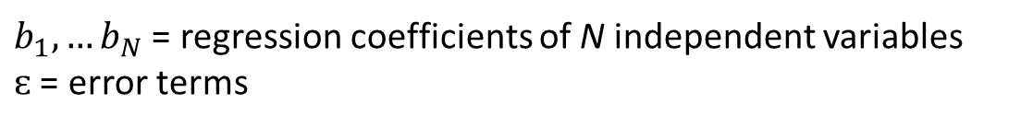

Part I: Linear Regression (numerical approach)
$$γ_{i} ε{ R}^{N+1}, i ϵ \left(1..k\right)$$
$$γ_{i}=\left(x_{i1}; x_{i2};…; x_{iN}; y_{i}\right)$$
$$y_{i}=b_{1}x_{i1}+b_{2}x_{i2}+…+b_{N}x_{iN}+ɛ_{i}$$
$b_{1},…b_{N}$ = regression coefficients of N independent variables
$ɛ$ = error terms

Slide 8
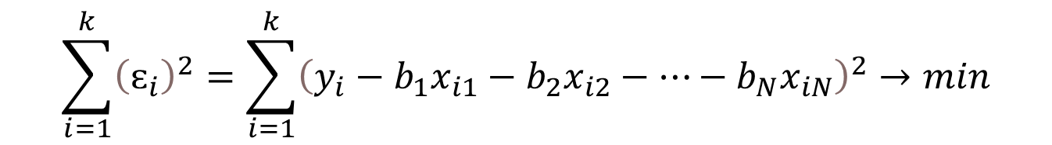

Part I: Linear Regression (numerical approach)
$$γ_{i} ε{ R}^{N+1}, i ϵ \left(1..k\right)$$
$$γ_{i}=\left(x_{i1}; x_{i2};…; x_{iN}; y_{i}\right)$$
$$y_{i}=b_{1}x_{i1}+b_{2}x_{i2}+…+b_{N}x_{iN}+ɛ_{i}$$
$b_{1},…b_{N}$ = regression coefficients of N independent variables
$ɛ$ = error terms
$$\sum_{i=1}^{k}{{\left(ɛ_{i}\right)}^{2}}=\sum_{i=1}^{k}{{\left(y_{i}−b_{1}x_{i1}−b_{2}x_{i2}−…−b_{N}x_{iN}\right)}^{2}}→min$$

Slide 9
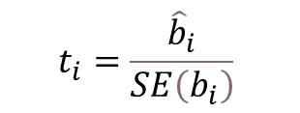

Part I: Linear Regression (numerical approach)
$$γ_{i} ε{ R}^{N+1}, i ϵ \left(1..k\right)$$
$$γ_{i}\left(x_{i1}; x_{i2};…; x_{iN}; y_{i}\right)$$
$$y_{i}=b_{1}x_{i1}+b_{2}x_{i2}+…+b_{N}x_{iN}+ɛ_{i}$$
$b_{1},…b_{N}$ = regression coefficients of N independent variables
$ɛ$ = error terms
$$\sum_{i=1}^{k}{{\left(ɛ_{i}\right)}^{2}}=\sum_{i=1}^{k}{{\left(y_{i}−b_{1}x_{i1}−b_{2}x_{i2}−…−b_{N}x_{iN}\right)}^{2}}→min$$
$$t_{i}=\frac{{\hat{b}}_{i}}{SE\left(b_{i}\right)}$$
$SE\left(b_{i}\right)$ = standard error of the regression coefficient estimate ${\hat{b}}_{i}$.

Slide 10
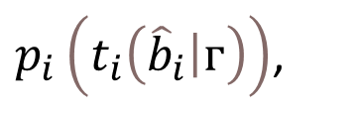
Part I: Linear Regression (numerical approach)
$$γ_{i} ε{ R}^{N+1}, i ϵ \left(1..k\right)$$
$p_{i}\left(t_{i}\left({\hat{b}}_{i}\left|ᴦ\right.\right)\right)$,
$$γ_{i}\left(x_{i1}; x_{i2};…; x_{iN}; y_{i}\right)$$
$$y_{i}=b_{1}x_{i1}+b_{2}x_{i2}+…+b_{N}x_{iN}+ɛ_{i}$$
$b_{1},…b_{N}$ = regression coefficients of N independent variables
$ɛ$ = error terms
$$\sum_{i=1}^{k}{{\left(ɛ_{i}\right)}^{2}}=\sum_{i=1}^{k}{{\left(y_{i}−b_{1}x_{i1}−b_{2}x_{i2}−…−b_{N}x_{iN}\right)}^{2}}→min$$
$$t_{i}=\frac{{\hat{b}}_{i}}{SE\left(b_{i}\right)}$$
$SE\left(b_{i}\right)$ = standard error of the regression coefficient estimate ${\hat{b}}_{i}$.

Slide 11
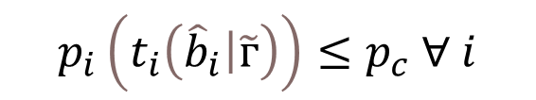
Part I: Linear Regression (numerical approach)
$$p_{i}\left(t_{i}\left({\hat{b}}_{i}\left|\tilde{ᴦ}\right.\right)\right)≤p_{c} ∀ i$$

Slide 12


Part I: Linear Regression (numerical approach)
$$p_{i}\left(t_{i}\left({\hat{b}}_{i}\left|\tilde{ᴦ}\right.\right)\right)≤p_{c} ∀ i$$
$$ᴦ= \left\{γ_{1}, { γ}_{2},…{ γ}_{k}\right\}$$
$$\tilde{ᴦ}= \left\{\tilde{γ_{1}},\tilde{γ_{2}},…\tilde{γ_{k}}\right\}$$

Slide 13

Part I: Linear Regression (numerical approach)
$$p_{i}\left(t_{i}\left({\hat{b}}_{i}\left|\tilde{ᴦ}\right.\right)\right)≤p_{c} ∀ i$$
$$ᴦ= \left\{γ_{1}, { γ}_{2},…{ γ}_{k}\right\}$$
$$\tilde{ᴦ}= \left\{\tilde{γ_{1}},\tilde{γ_{2}},…\tilde{γ_{k}}\right\}$$
$$U_{ᴦ}\left(h\right)=\left\{ᴦ:{\left(γ_{i}−{\tilde{γ}}_{i}\right)}^{T}\left(γ_{i}−{\tilde{γ}}_{i}\right)≤h, i=1..k\right\}, h≥0,$$
$h$ = horizon of uncertainty

Slide 14
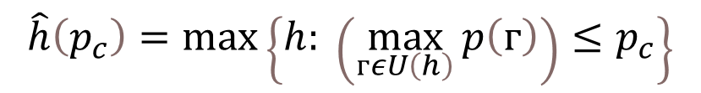
Part I: Linear Regression (numerical approach)
$$p_{i}\left(t_{i}\left({\hat{b}}_{i}\left|\tilde{ᴦ}\right.\right)\right)≤p_{c} ∀ i$$
$$ᴦ= \left\{γ_{1}, { γ}_{2},…{ γ}_{k}\right\}$$
$$\tilde{ᴦ}= \left\{\tilde{γ_{1}},\tilde{γ_{2}},…\tilde{γ_{k}}\right\}$$
$$U_{ᴦ}\left(h\right)=\left\{ᴦ:{\left(γ_{i}−{\tilde{γ}}_{i}\right)}^{T}\left(γ_{i}−{\tilde{γ}}_{i}\right)≤h, i=1..k\right\}, h≥0,$$
$h$ = horizon of uncertainty
$$\hat{h}\left(p_{c}\right)=\max\left\{h: \left(\max_{ᴦεU\left(h\right)}{p\left(ᴦ\right)}\right)≤p_{c}\right\}$$

Slide 15
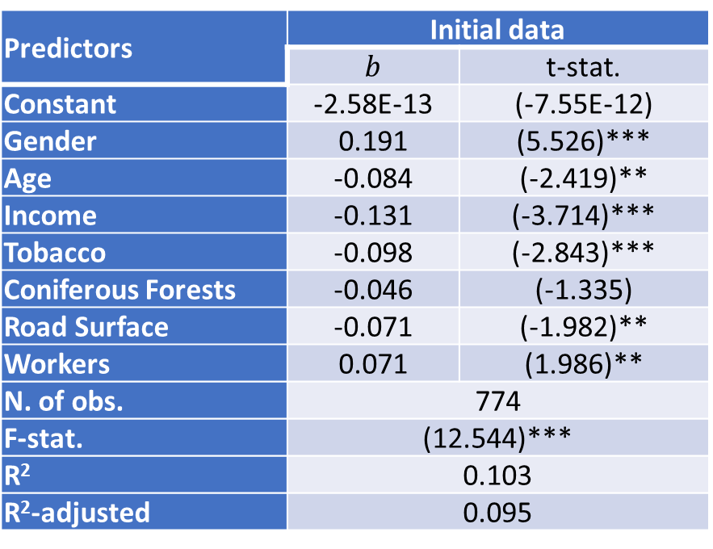
Part I: Linear Regression (numerical approach)
Predictors | Initial data
 | $b$ | t-stat.
Constant | -2.58E-13 | (-7.55E-12)
Gender | 0.191 | (5.526)***
Age | -0.084 | (-2.419)**
Income | -0.131 | (-3.714)***
Tobacco | -0.098 | (-2.843)***
Coniferous Forests | -0.046 | (-1.335)
Road Surface | -0.071 | (-1.982)**
Workers | 0.071 | (1.986)**
N. of obs. | 774
F-stat. | (12.544)***
R² | 0.103
R²-adjusted | 0.095
Associations between internalized difficulties with individual self-reported and IRIS-level characteristics across TEMPO project respondents before the Covid-19 pandemic (Model type – OLS linear regression)
Significance of t- and F-statistics: *** - at greater than 99% level, ** - at greater than 95% level, * - at greater than 90% level.

Slide 16
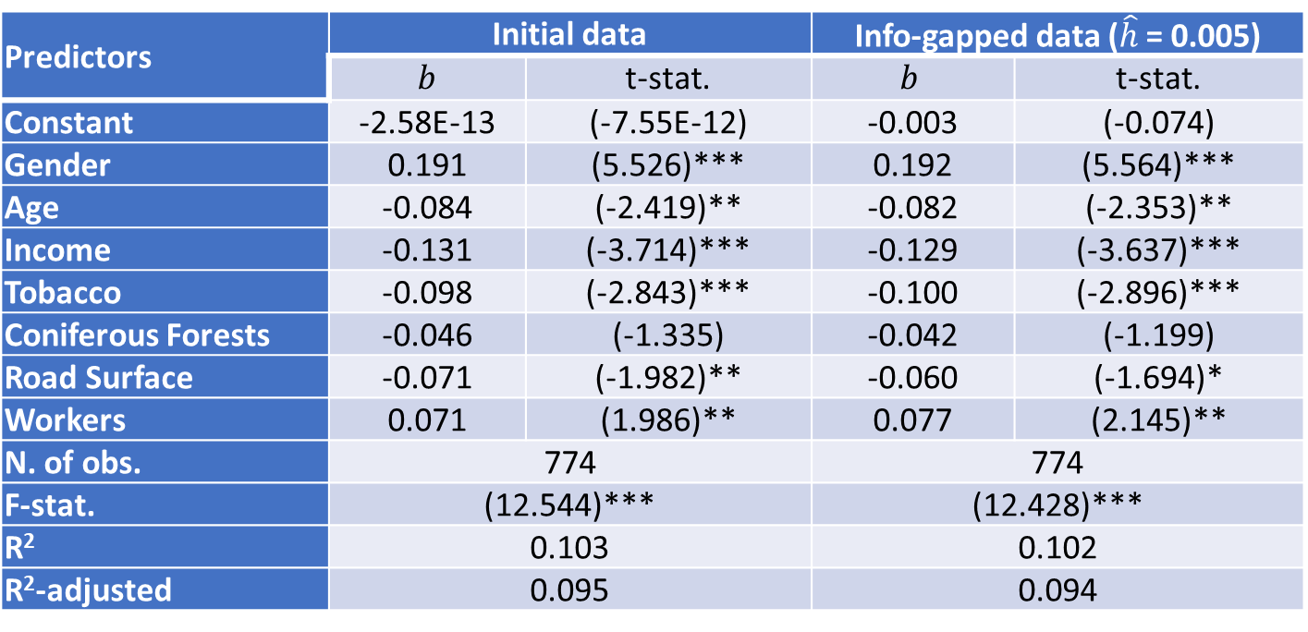
Part I: Linear Regression (numerical approach)
Predictors | Initial data |  | Info-gapped data ($\hat{h}$ = 0.005)
 | $b$ | t-stat. | $$b$$ | t-stat.
Constant | -2.58E-13 | (-7.55E-12) | -0.003 | (-0.074)
Gender | 0.191 | (5.526)*** | 0.192 | (5.564)***
Age | -0.084 | (-2.419)** | -0.082 | (-2.353)**
Income | -0.131 | (-3.714)*** | -0.129 | (-3.637)***
Tobacco | -0.098 | (-2.843)*** | -0.100 | (-2.896)***
Coniferous Forests | -0.046 | (-1.335) | -0.042 | (-1.199)
Road Surface | -0.071 | (-1.982)** | -0.060 | (-1.694)*
Workers | 0.071 | (1.986)** | 0.077 | (2.145)**
N. of obs. | 774 |  | 774
F-stat. | (12.544)*** |  | (12.428)***
R² | 0.103 |  | 0.102
R²-adjusted | 0.095 |  | 0.094
Associations between internalized difficulties with individual self-reported and IRIS-level characteristics across TEMPO project respondents before the Covid-19 pandemic (Model type – OLS linear regression)
Significance of t- and F-statistics: *** - at greater than 99% level, ** - at greater than 95% level, * - at greater than 90% level.

Slide 17
Part II: Linear Regression (analytical approach)
Notes:
Two approaches: why?

Slide 18
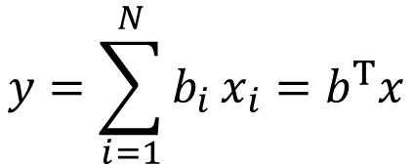



Part II: Linear Regression (analytical approach)
$$y=\sum_{i=1}^{N}{b_{i}}x_{i}=b^{T}x$$
$$x_{1},…x_{N}$$
are N independent variables
$$y$$
is dependent variable
$$b_{1},…b_{N}$$
are regression coefficients

Slide 19

Part II: Linear Regression (analytical approach)
$$y=\sum_{i=1}^{N}{b_{i}}x_{i}=b^{T}x$$
$$x_{1},…x_{N}$$
are N independent variables
$$y$$
is dependent variable
$$b_{1},…b_{N}$$
are regression coefficients
$${\left(y−b^{T}x\right)}^{2}≤ɛ_{c}^{2}$$

Slide 20
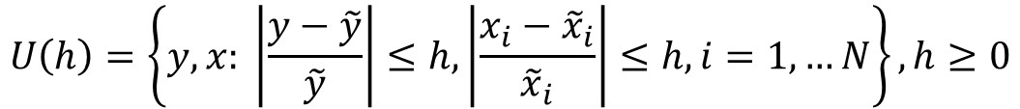
Part II: Linear Regression (analytical approach)
$$y=\sum_{i=1}^{N}{b_{i}}x_{i}=b^{T}x$$
$$U\left(h\right)=\left\{y, x: \left|\frac{y−\tilde{y}}{\tilde{y}}\right|≤h,\left|\frac{x_{i}−{\tilde{x}}_{i}}{{\tilde{x}}_{i}}\right|≤h, i=1,…N\right\}, h≥0$$
$$x_{1},…x_{N}$$
are N independent variables
$$y$$
is dependent variable
$$b_{1},…b_{N}$$
are regression coefficients
$${\left(y−b^{T}x\right)}^{2}≤ɛ_{c}^{2}$$

Slide 21

Part II: Linear Regression (analytical approach)
$$y=\sum_{i=1}^{N}{b_{i}}x_{i}=b^{T}x$$
$$U\left(h\right)=\left\{y, x: \left|\frac{y−\tilde{y}}{\tilde{y}}\right|≤h,\left|\frac{x_{i}−{\tilde{x}}_{i}}{{\tilde{x}}_{i}}\right|≤h, i=1,…N\right\}, h≥0$$
$$x_{1},…x_{N}$$
are N independent variables
$$\hat{h}\left(ɛ_{c},b\right)=\max\left\{h: \left(\max_{y,xϵU\left(h\right)}{{\left(y−b^{T}x\right)}^{2}}\right)≤ɛ_{c}^{2}\right\}$$
$$y$$
is dependent variable
$$b_{1},…b_{N}$$
are regression coefficients
$${\left(y−b^{T}x\right)}^{2}≤ɛ_{c}^{2}$$

Slide 22
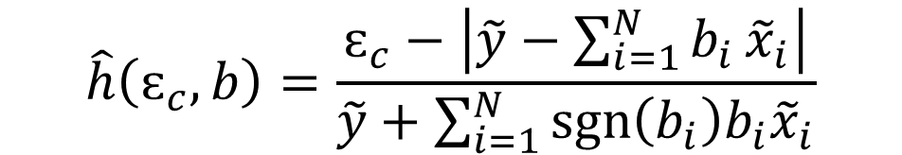
Part II: Linear Regression (analytical approach)
$$y=\sum_{i=1}^{N}{b_{i}}x_{i}=b^{T}x$$
$$U\left(h\right)=\left\{y, x: \left|\frac{y−\tilde{y}}{\tilde{y}}\right|≤h,\left|\frac{x_{i}−{\tilde{x}}_{i}}{{\tilde{x}}_{i}}\right|≤h, i=1,…N\right\}, h≥0$$
$$x_{1},…x_{N}$$
are N independent variables
$$\hat{h}\left(ɛ_{c},b\right)=\max\left\{h: \left(\max_{y,xϵU\left(h\right)}{{\left(y−b^{T}x\right)}^{2}}\right)≤ɛ_{c}^{2}\right\}$$
$$y$$
is dependent variable
$$b_{1},…b_{N}$$
are regression coefficients
$$\hat{h}\left(ɛ_{c},b\right)=\frac{ɛ_{c}−\left|\tilde{y}−\sum_{i=1}^{N}{b_{i}}{\tilde{x}}_{i}\right|}{\tilde{y}+\sum_{i=1}^{N}{\operatorname{sgn}\left(b_{i}\right)b_{i}{\tilde{x}}_{i}}}$$
$${\left(y−b^{T}x\right)}^{2}≤ɛ_{c}^{2}$$

Slide 23
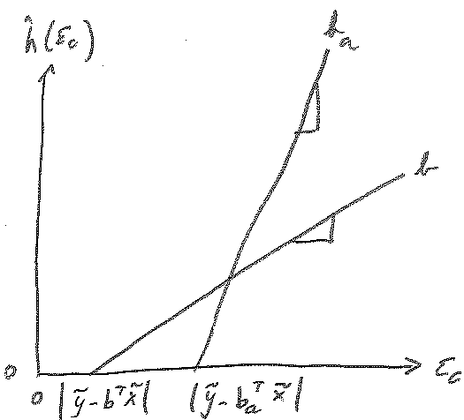
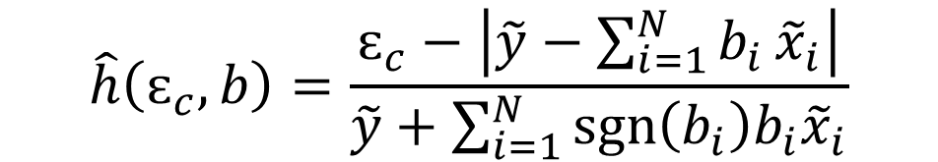
Part II: Linear Regression (analytical approach)
Sub-optimal regression coefficients and preference reversal
$$\hat{h}\left(ɛ_{c},b\right)=\frac{ɛ_{c}−\left|\tilde{y}−\sum_{i=1}^{N}{b_{i}}{\tilde{x}}_{i}\right|}{\tilde{y}+\sum_{i=1}^{N}{\operatorname{sgn}\left(b_{i}\right)b_{i}{\tilde{x}}_{i}}}$$

Slide 24

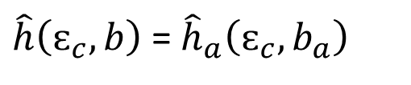
Part II: Linear Regression (analytical approach)
Sub-optimal regression coefficients and preference reversal
$$\hat{h}\left(ɛ_{c},b\right)=\frac{ɛ_{c}−\left|\tilde{y}−\sum_{i=1}^{N}{b_{i}}{\tilde{x}}_{i}\right|}{\tilde{y}+\sum_{i=1}^{N}{\operatorname{sgn}\left(b_{i}\right)b_{i}{\tilde{x}}_{i}}}$$
$\hat{h}\left(ɛ_{c},b\right)$ = ${\hat{h}}_{a}\left(ɛ_{c},b_{a}\right)$
$$b_{a}=kb$$

Slide 25
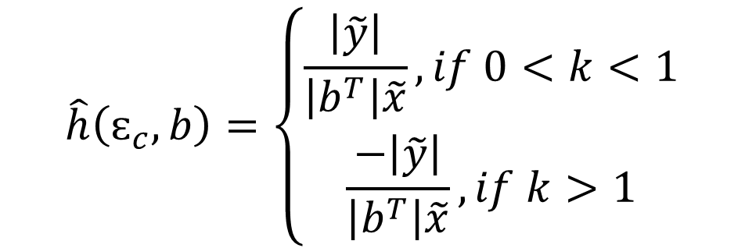
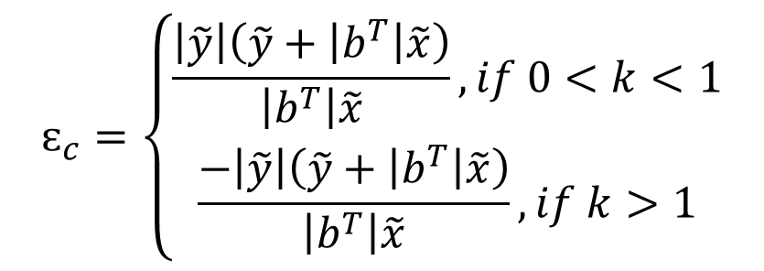
Part II: Linear Regression (analytical approach)
Sub-optimal regression coefficients and preference reversal
$$ɛ_{c}=\left\{\begin{matrix}\frac{\left|\tilde{y}\right|\left(\tilde{y}+\left|b^{T}\right|\tilde{x}\right)}{\left|b^{T}\right|\tilde{x}}, if 0<k<1 \\ \frac{−\left|\tilde{y}\right|\left(\tilde{y}+\left|b^{T}\right|\tilde{x}\right)}{\left|b^{T}\right|\tilde{x}}, if k>1\end{matrix}\right.$$
$$\hat{h}\left(ɛ_{c},b\right)=\left\{\begin{aligned}\frac{\left|\tilde{y}\right|}{\left|b^{T}\right|\tilde{x}},if 0<k<1 \\ \frac{−\left|\tilde{y}\right|}{\left|b^{T}\right|\tilde{x}},if k>1\end{aligned}\right.$$

Slide 26
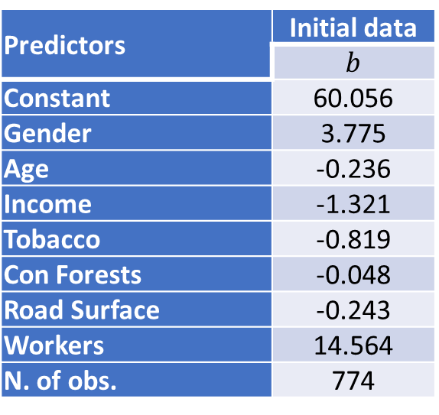
Associations between internalized difficulties with individual self-reported and IRIS-level characteristics across TEMPO project respondents before the Covid-19 pandemic (Model type – OLS linear regression)
Predictors | Initial data
 | $b$
Constant | 60.056
Gender | 3.775
Age | -0.236
Income | -1.321
Tobacco | -0.819
Con Forests | -0.048
Road Surface | -0.243
Workers | 14.564
N. of obs. | 774

Slide 27
Associations between internalized difficulties with individual self-reported and IRIS-level characteristics across TEMPO project respondents before the Covid-19 pandemic (Model type – OLS linear regression)
Predictors | Initial data
 | $b$
Constant | 60.056
Gender | 3.775
Age | -0.236
Income | -1.321
Tobacco | -0.819
Con Forests | -0.048
Road Surface | -0.243
Workers | 14.564
N. of obs. | 774

Slide 28
Associations between internalized difficulties with individual self-reported and IRIS-level characteristics across TEMPO project respondents before the Covid-19 pandemic (Model type – OLS linear regression)
Predictors | Initial data
 | $b$
Constant | 60.056
Gender | 3.775
Age | -0.236
Income | -1.321
Tobacco | -0.819
Con Forests | -0.048
Road Surface | -0.243
Workers | 14.564
N. of obs. | 774

Slide 29

Associations between internalized difficulties with individual self-reported and IRIS-level characteristics across TEMPO project respondents before the Covid-19 pandemic (Model type – OLS linear regression)
Predictors | Initial data
 | $b$
Constant | 60.056
Gender | 3.775
Age | -0.236
Income | -1.321
Tobacco | -0.819
Con Forests | -0.048
Road Surface | -0.243
Workers | 14.564
N. of obs. | 774
$$\tilde{y}=49.85$$

Slide 30
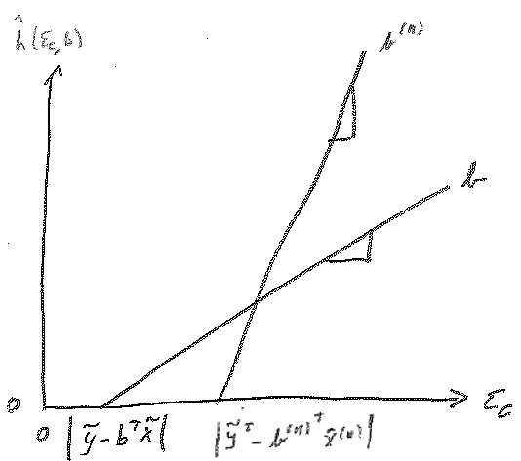
Part II: Linear Regression (analytical approach)
Assessing the impact of an individual explanatory variable
$$\hat{h}\left(ɛ_{c},b\right)=\frac{ɛ_{c}−\left|\tilde{y}−\sum_{i=1}^{N}{b_{i}}{\tilde{x}}_{i}\right|}{\tilde{y}+\sum_{i=1}^{N}{\operatorname{sgn}\left(b_{i}\right)b_{i}{\tilde{x}}_{i}}}$$

Slide 31

Part II: Linear Regression (analytical approach)
Assessing the impact of an individual explanatory variable
$$\hat{h}\left(ɛ_{c},b\right)=\frac{ɛ_{c}−\left|\tilde{y}−\sum_{i=1}^{N}{b_{i}}{\tilde{x}}_{i}\right|}{\tilde{y}+\sum_{i=1}^{N}{\operatorname{sgn}\left(b_{i}\right)b_{i}{\tilde{x}}_{i}}}$$
$$b^{(n)}=\left(b\left(n\right)=0\right)$$

Slide 32
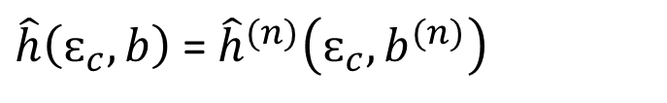
Part II: Linear Regression (analytical approach)
Assessing the impact of an individual explanatory variable
$$\hat{h}\left(ɛ_{c},b\right)=\frac{ɛ_{c}−\left|\tilde{y}−\sum_{i=1}^{N}{b_{i}}{\tilde{x}}_{i}\right|}{\tilde{y}+\sum_{i=1}^{N}{\operatorname{sgn}\left(b_{i}\right)b_{i}{\tilde{x}}_{i}}}$$
$$b^{(n)}=\left(b\left(n\right)=0\right)$$
$\hat{h}\left(ɛ_{c},b\right)$ = ${\hat{h}}^{(n)}\left(ɛ_{c}, b^{(n)}\right)$

Slide 33
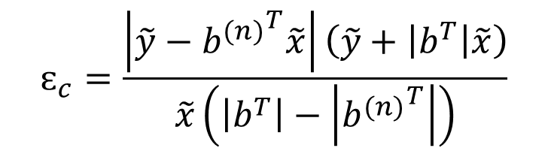
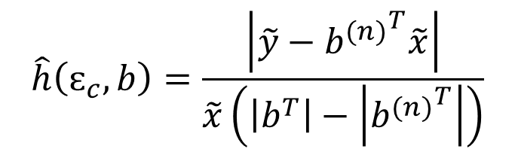
Part II: Linear Regression (analytical approach)
Assessing the impact of an individual explanatory variable
$$ɛ_{c}=\frac{\left|\tilde{y}−{b^{(n)}}^{T}\tilde{x}\right|\left(\tilde{y}+\left|b^{T}\right|\tilde{x}\right)}{\tilde{x}\left(\left|b^{T}\right|−\left|{b^{(n)}}^{T}\right|\right)}$$
$$\hat{h}\left(ɛ_{c},b\right)=\frac{\left|\tilde{y}−{b^{(n)}}^{T}\tilde{x}\right|}{\tilde{x}\left(\left|b^{T}\right|−\left|{b^{(n)}}^{T}\right|\right)}$$

Slide 34
Associations between internalized difficulties with individual self-reported and IRIS-level characteristics across TEMPO project respondents before the Covid-19 pandemic (Model type – OLS linear regression)
Predictors | Initial data
 | $b$
Constant | 60.056
Gender | 3.775
Age | -0.236
Income | -1.321
Tobacco | -0.819
Con Forests | -0.048
Road Surface | -0.243
Workers | 14.564
N. of obs. | 774

Slide 35
Associations between internalized difficulties with individual self-reported and IRIS-level characteristics across TEMPO project respondents before the Covid-19 pandemic (Model type – OLS linear regression)
Predictors | Initial data
 | $b$
Constant | 60.056
Gender | 3.775
Age | -0.236
Income | -1.321
Tobacco | -0.819
Con Forests | -0.048
Road Surface | -0.243
Workers | 14.564
N. of obs. | 774

Slide 36

Associations between internalized difficulties with individual self-reported and IRIS-level characteristics across TEMPO project respondents before the Covid-19 pandemic (Model type – OLS linear regression)
Predictors | Initial data
 | $b$
Constant | 60.056
Gender | 3.775
Age | -0.236
Income | -1.321
Tobacco | -0.819
Con Forests | -0.048
Road Surface | -0.243
Workers | 14.564
N. of obs. | 774
$$\tilde{y}=49.85$$

Slide 37
Numerical
Comparison of the two approaches
vs.
Analytical

Slide 38
Numerical
Comparison of the two approaches
vs.
Analytical
High computational load
Inherits all statistical assumptions featured by linear regression models
Assumptions for choosing the reference estimates of b-coefficients

Slide 39
Numerical
Comparison of the two approaches
vs.
Analytical
High computational load
Inherits all statistical assumptions featured by linear regression models
Assumptions for choosing the reference estimates of b-coefficients

Slide 40
Numerical
Comparison of the two approaches
vs.
Analytical
High computational load
Inherits all statistical assumptions featured by linear regression models
Assumptions for choosing the reference estimates of b-coefficients

Slide 41
Thanks!
nataliya.rybnikova@gmail.com

